Slide 1
4991 Capstone Course
Final Proposal Presentation

Slide 2
Overview
With the needs of financial decision to manage our money we are focusing on creating a software application that can benefit lots of targets such as investors, customers and government entities.
The function of the application will be relying on financial statements which will be evaluated with specific methods.
The calculations and measures will be processed and
coded to give output which are evaluations of
some companies and indicators
of their stocks.

Slide 3
Definition of the Problem
Slow and long process on investments
High cost of financial consulting firms
The lack of fast financial softwares
Time Consuming of manual analysis

Slide 4

Conceptual Solution
Web based application
Includes financial analysis model
Buy, hold, sell predictions
Acts based on the user’s input of balance sheets and income statements

Slide 5
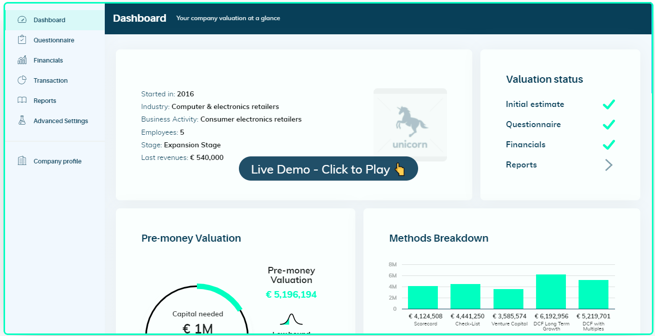
Similar Products - Equidam

Slide 6
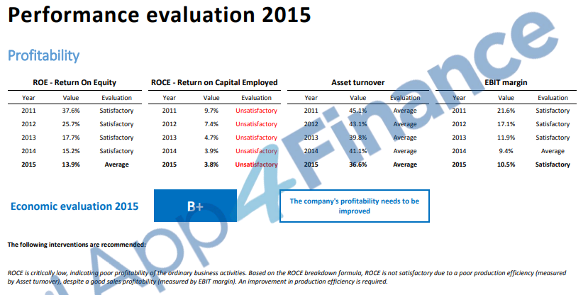
Similar Products - App4Finance

Slide 7
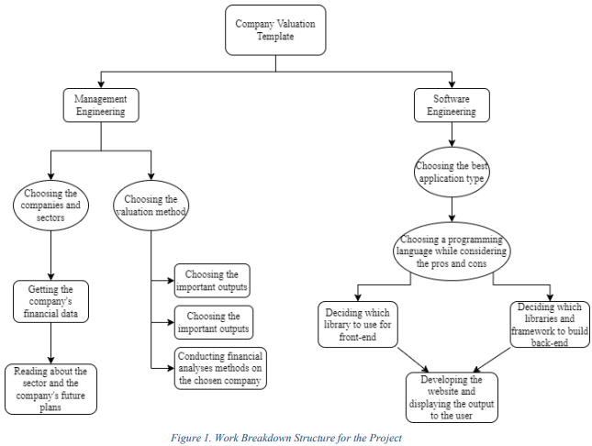
Work Breakdown Structure

Slide 8
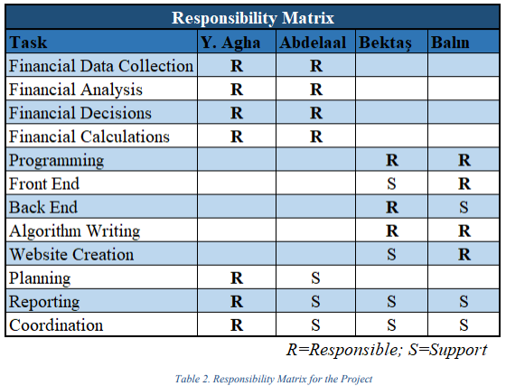
Responsibility Matrix (RM)

Slide 9
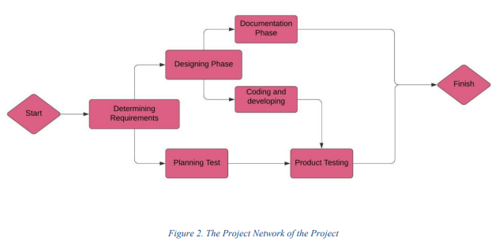
Project Network (PN)

Slide 10
Gantt Chart

Slide 11
Gantt Chart

Slide 12
Gantt Chart

Slide 13
Gantt Chart

Slide 14
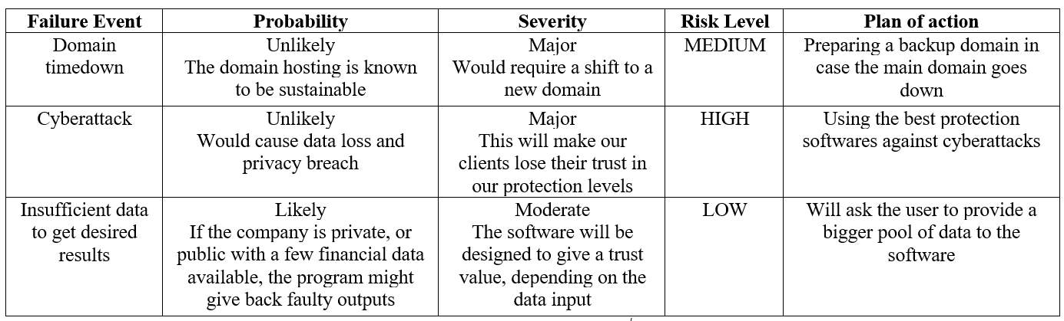
Risk Assessment

Slide 15
Management Engineering Sub-Team
The team will be responsible for the financial analysis and the required calculations for the financial methodology.
Providing some guidance or help to the investors, through the financial model
to buy, sell or hold their stocks.

Slide 16
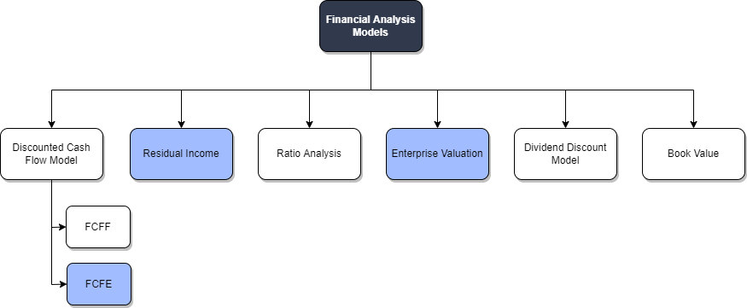
Financial Models/Methodologies

Slide 17
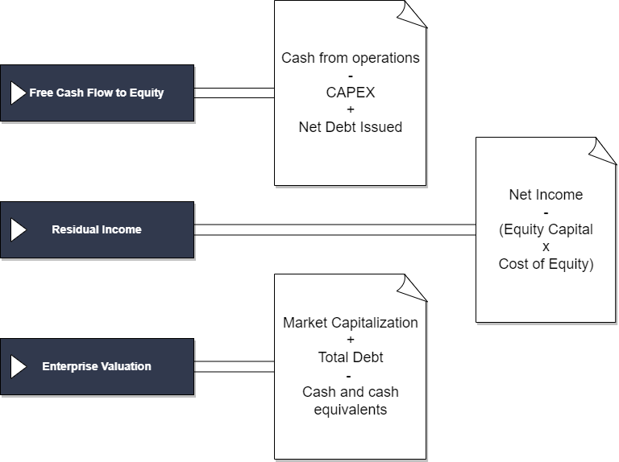
Proposed Solutions

Slide 18

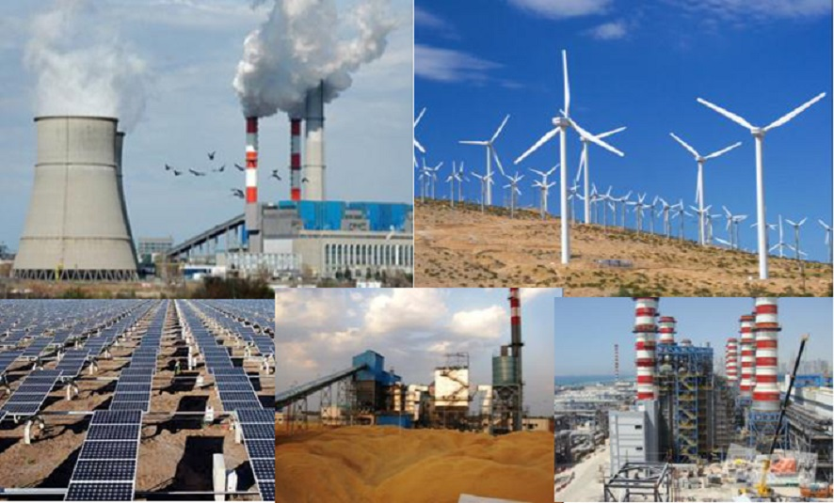


Data Collection: The Companies
Energy Sector
EST. 1997
EST. 2010
EST. 1989

Slide 19





Data Collection: The Companies
Retail Sector
EST. 1955
EST. 1954
EST. 1991
EST. 1943

Slide 20





Data Collection: The Companies
Electronics Sector
EST. 1955
EST. 1955
EST. 1984
EST. 2000

Slide 21


Data Collection: The Companies
Petroleum Sector
EST. 1983

Slide 22

Data Analysis
After collecting the data from Bloomberg and other sources
Data analysis will be conducted on the data pool using the methodologies mentioned above
MS Excel will be used during this phase

Slide 23
Software Engineering Sub-Team
Software sub-team will be doing implementation of the methods and calculations of the inputs that comes from Engineering management
App will be web based
Available to get investment

Slide 24
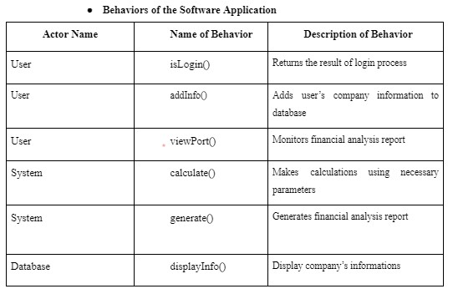
Requirements
Functional
Requirements

Slide 25
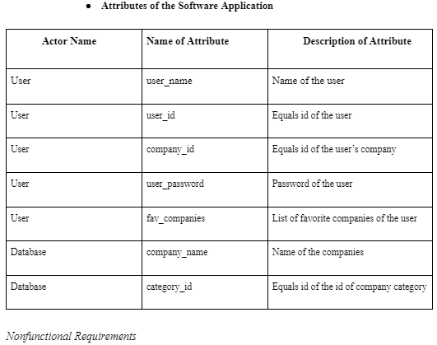
Attributes of the
Application

Slide 26
Requirements
Nonfunctional
Requirements
Performance Requirements
1- Rapid calculation
2- Clear and understandable interface
Safety Requirements
1- No physical damage risk
2- Last decision up to user
Security Requirements
1- App does not keep private datas
2- Login informations are encrypted

Slide 27
Technologies
and Methods
Programming
Languages
Pros and Cons
HTML5
Python
JavaScript
CSS

Slide 28
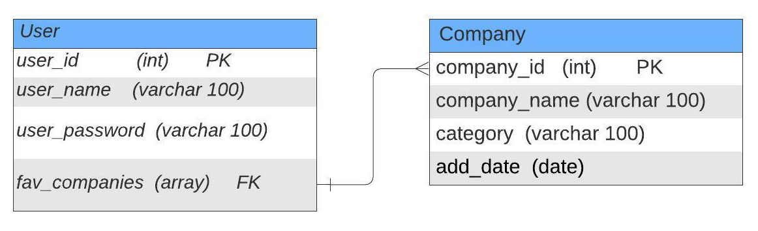
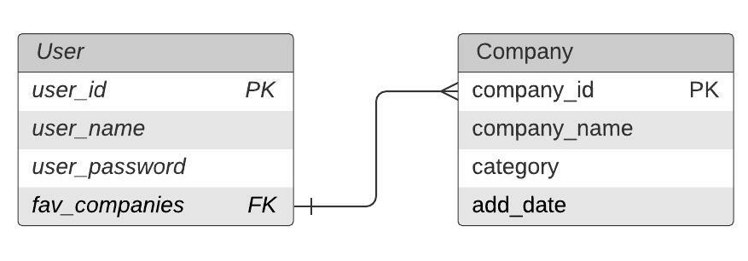
Database
Management System

Slide 29
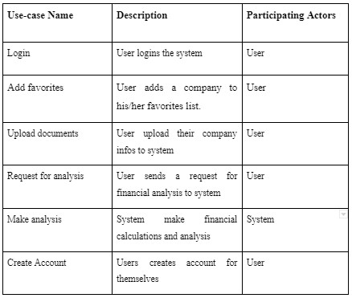
Conceptualizing
Actor Glossary
User
System
Database

Slide 30
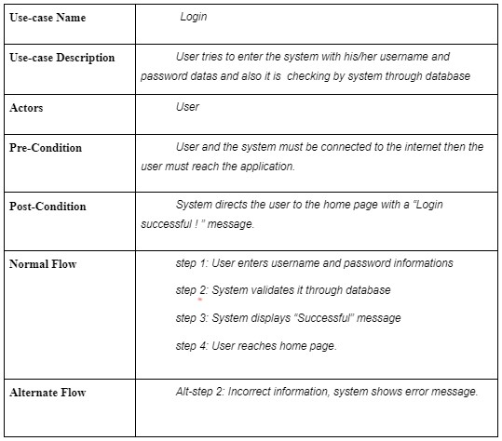
Use-case
Scenarios

Slide 31
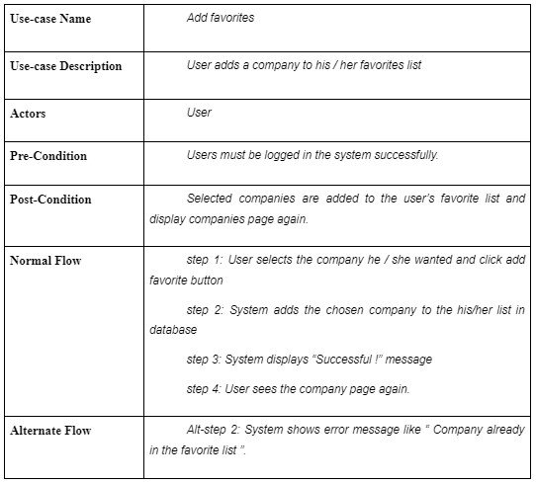
Use-case
Scenarios

Slide 32
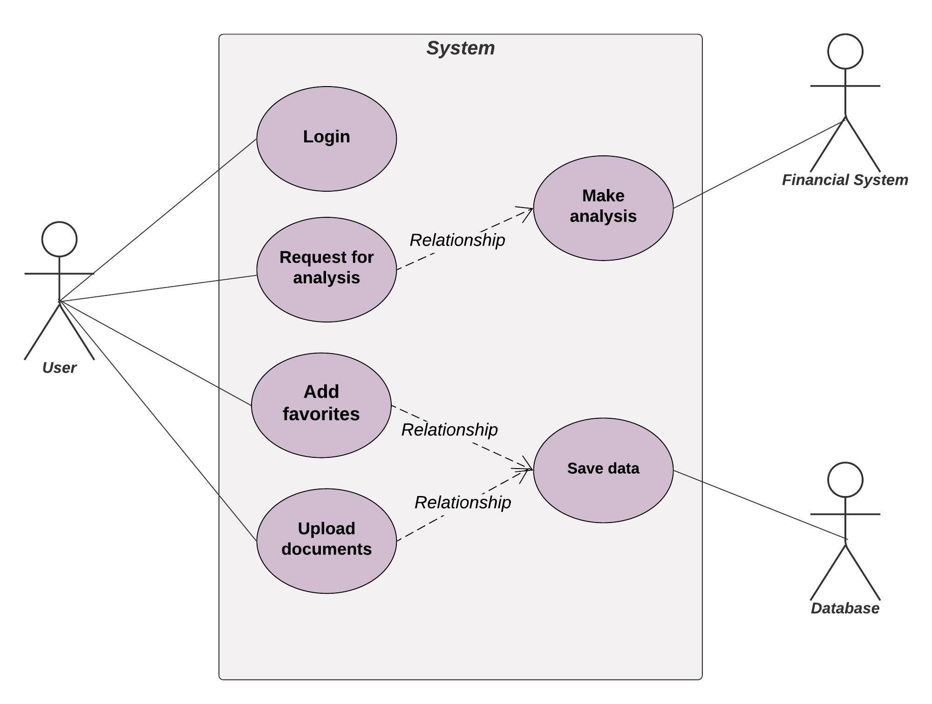
Use-case
Diagram

Slide 33
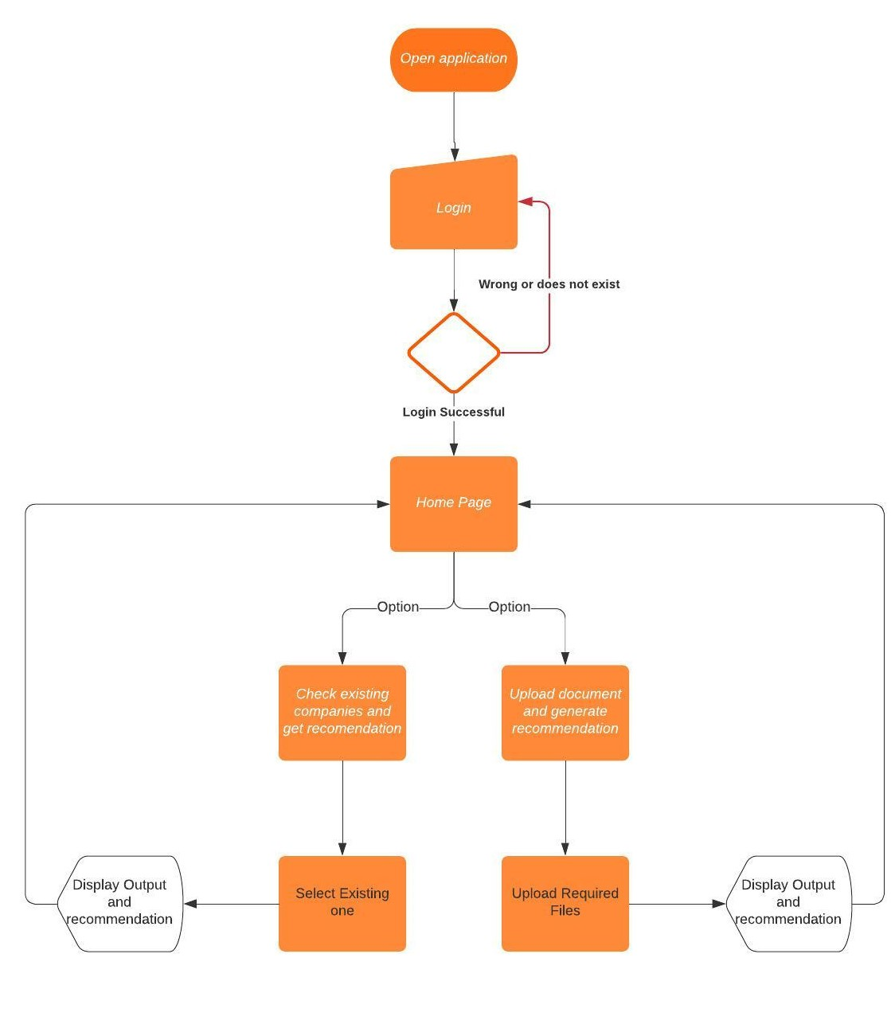
Activity
Diagram

Slide 34
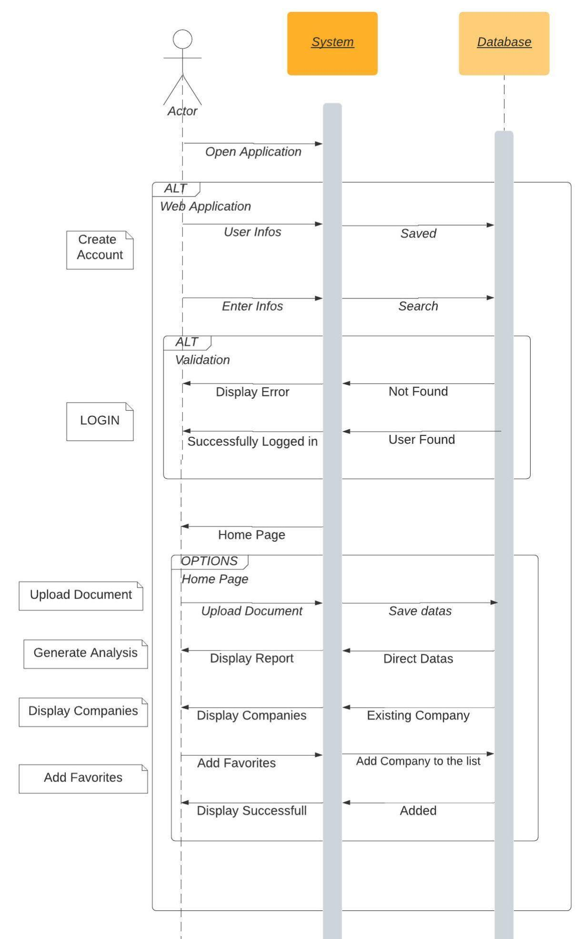
Sequence Diagram
And

Slide 35
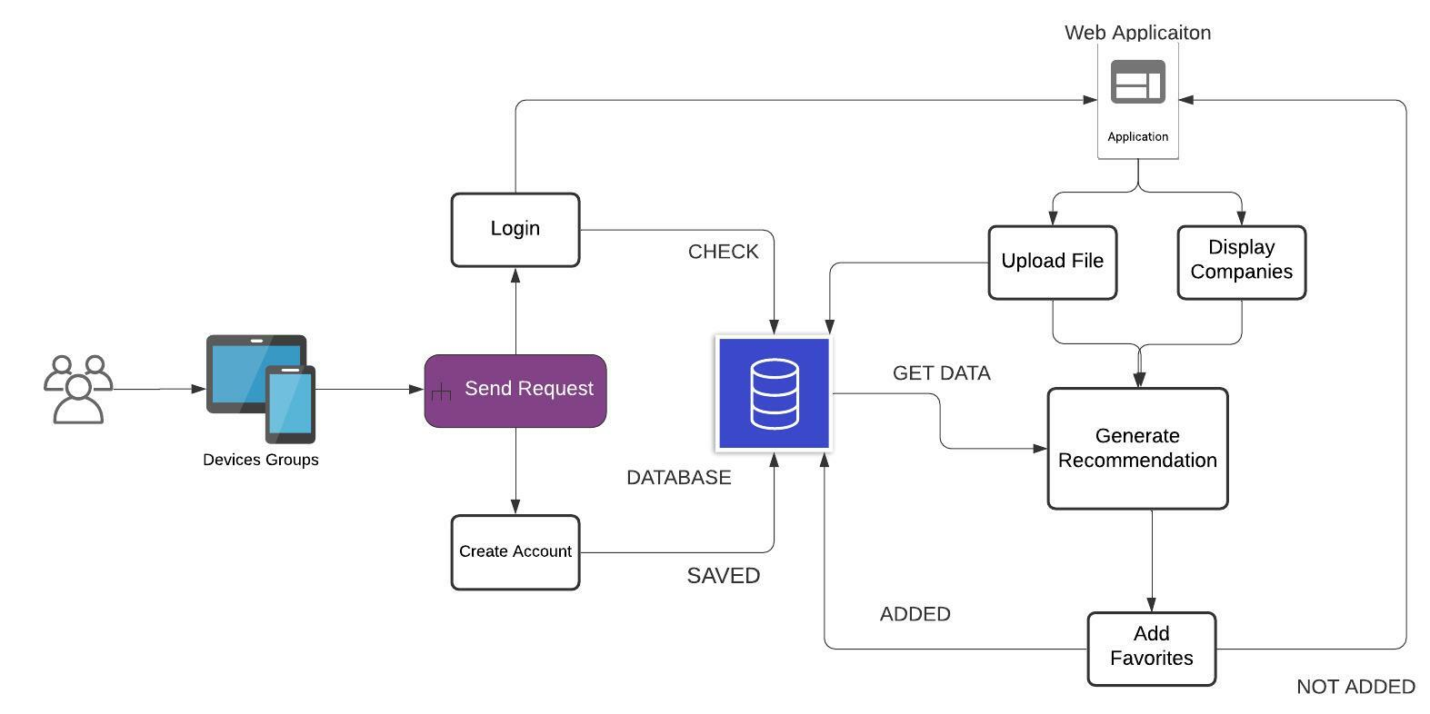
Software Architecture Diagram

Slide 36
Conclusion
The product will significantly beneficial, since it will provide all the financial analysis needed in much more efficient way with the required quality and precision. Moreover, the application will be having the ability to help with decision making as a financial consultant, or investor, by giving the output needed in the decision making process.
So to conclude this product is combination of financial evaluation results and indicators, with less time, and no cost.

